Slide 1
Chapter 8: Group Behavior

Slide 2
Learning Objectives
How are people changed through their group membership, and how is the group changed by members' ideas and actions?
How do groups sometimes lower the inhibitions of members, causing them to impulsively engage in such antisocial behavior as vandalism, aggression, and rioting?
Are group decisions more or less cautious than individual decisions?
What is more important in determining the effectiveness of leaders—their personalities or the factors they encounter?

Slide 3
Groups and Their Purpose
Group: several interdependent people who have emotional ties and interact regularly
Groups accomplish instrumental tasks.
People often join groups because they desire to achieve task-oriented goals they cannot attain alone.
Groups meet socioemotional needs.
Becoming a group member helps to satisfy affiliative motives, such as the desire for approval, belonging, prestige, friendship, and even love.

Slide 4
Temporal Model of Group Membership
Group membership changes in predictable ways over time.
Stages
Investigation
Socialization
Maintenance
Resocialization
Remembrance

Slide 5
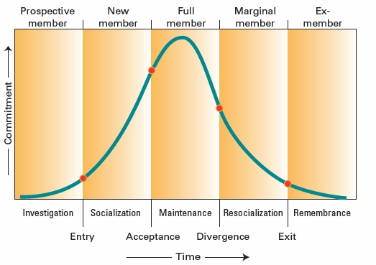
Figure 8.1 A Temporal Model of Group Membership

Slide 6
Group Structure
Social norms
Expected standards of behavior
Stable over time
Social roles
Expectations for group members
Status systems
Distribution of power among members

Slide 7
Group Success Fosters Social Identification
When groups succeed, we Bask In Reflected Glory (BIRG)
"We won!"
When groups fail, we Cut Off Reflected Failure (CORF)
"They lost!"

Slide 8
Social Cohesiveness
Cohesion affected by
Group size
Most groups < 4 people.
More than 150 people strains innate capacity.
Member similarity/diversity
Embracing diversity enhances problem solving.
Perceived subversion of group's identity
Allowing moderate dissent can maintain cohesion.

Slide 9
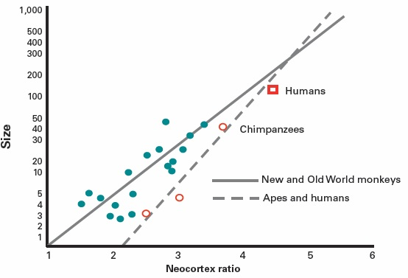
Figure 8.2 Does Brain Size Limit the Size of Social Groups in Primates?

Slide 10
Social Facilitation
The presence of others enhances the performance of easy tasks, but interferes with difficult tasks.
Possible explanations:
The mere presence of conspecifics increases arousal.
Evaluation apprehension diverts cognitive resources.
Distraction-conflict: Presence of conspecifics raises the question of what to attend to—others or the task.

Slide 11
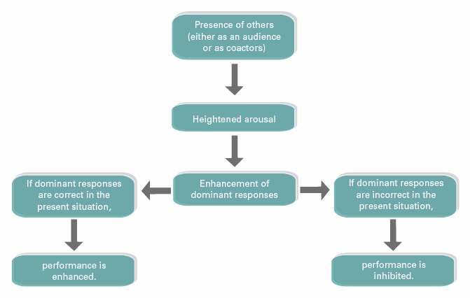
Figure 8.3 Zajonc’s Drive Theory of Social Facilitation

Slide 12
Social Loafing
When individual efforts are pooled, each person contributes less than when they are alone.
Seen in behavior and cognitive tasks
Likely cause: diffusion of responsibility

Slide 13
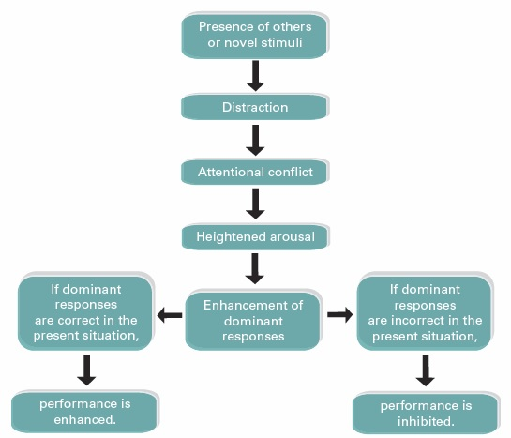
Figure 8.4 Distraction-Conflict Theory

Slide 14
Reducing Social Loafing
Makes individual effort identifiable
Provides potential for evaluation
Social ostracism of loafers
Decreased loafing among the emotionally expressive
Had no effect on the emotionally unexpressive

Slide 15
When Do Groups Help?
Group settings often lower motivation to perform.
However, highly motivated, competent people may work harder in group settings.
Low-skilled people may experience less evaluation apprehension and improve performance.

Slide 16
Deindividuation
In groups, people experience:
Arousal
Diffusion of responsibility
Feelings of anonymity
As a result:
Inhibitions are lowered
Self-awareness decreases

Slide 17
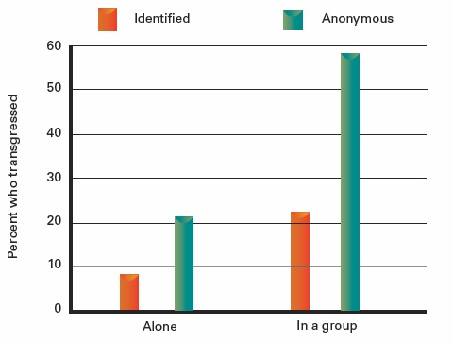
Figure 8.5 Effects of Deindividuation on Stealing Among Halloween Trick-or-Treaters

Slide 18
Group Decision-Making Stages
Orientation
Identify task and strategy.
Discussion
Gather information and evaluate possible solutions.
Decision
Make a choice based on decision rules.
Implementation
Carry out the decision and evaluate it.

Slide 19
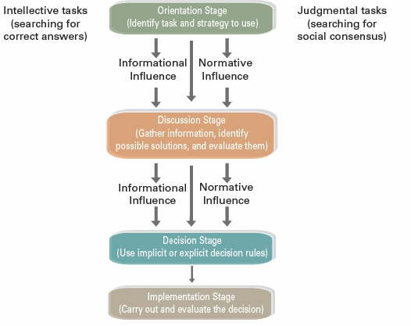
Figure 8.6 The Stages of Group Decision Making

Slide 20
Factors Influencing Group Decisions
Type of issue
Intellectual vs. judgmental
Type of social influence
Informational vs. normative
Type of decision rule
Unanimity, majority wins, or plurality wins

Slide 21
Group Polarization
Initially called "risky shift"
Discussion enhances group members' original opinions.
More likely on important issues
Mechanisms
Social comparison (normative influence)
Persuasive arguments (informational influence)

Slide 22
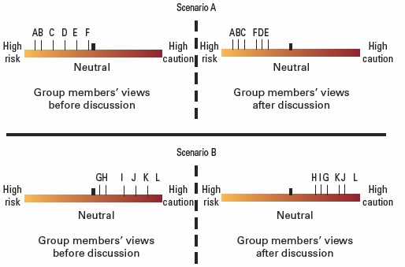
Figure 8.7 The Process of Group Polarization

Slide 23
Groupthink
An extreme form of group polarization
Decreased mental efficiency
Lack of reality testing
Deteriorated moral judgment
Risk factors for groupthink
High group cohesiveness
Threatening situational context
Structural and procedural faults

Slide 24
Symptoms of Groupthink
Overestimation of the ingroup
Perceived invulnerability
Unquestioned belief in own groups' morality
Close-mindedness
Rationalized judgments
Stereotypes of opponents
Increased conformity pressure
Self-censorship
Suppression of internal criticism

Slide 25
Leadership
Two kinds of leadership activities
Task leadership
Socioemotional leadership
Leaders who combine both in a flexible style get high marks from followers.
Few personality traits are common to effective leadership.

Slide 26
Transformational Leaders
Change the outlook of followers, allowing them to move beyond self-interest to group interest.
Three components
Charismatic communication
Convey a vision
Implement a vision

Slide 27
Contingency Model of Leadership
Leaders are effective when their traits match the situation.
Leaders can be task-oriented or relationship-oriented.
When situational control is:
Low or high, a task-oriented leader is preferred
Moderate, a relationship-oriented leader is preferred

Slide 28
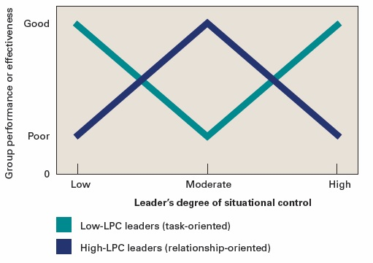
Figure 8.8 Predicting Group Effectiveness Based on Leadership Style and Situational Control

Slide 29
Gender, Culture, and Leadership
There are more gender similarities than differences.
Female leaders are as task-oriented as male leaders.
Females tend toward a more democratic leadership style.
Leader prototype is associated with male stereotype.
An ideal leader varies by culture.
Members of individualist cultures are more responsive to task-oriented leaders than members of collectivist cultures.

Slide 30
Social Dilemmas
The best short-term choice for individuals leads to a poor outcome for the group in the long run.
Examples:
Problem of the commons (resource dilemma)
Free rider problem
Prisoner's dilemma

Slide 31
Ways to Resolve Social Dilemmas
Sanctioning systems to promote cooperative behavior
Education about social dilemmas
Making group identification salient
Promoting a cooperative orientation
Promoting group discussion about the dilemma

Slide 32
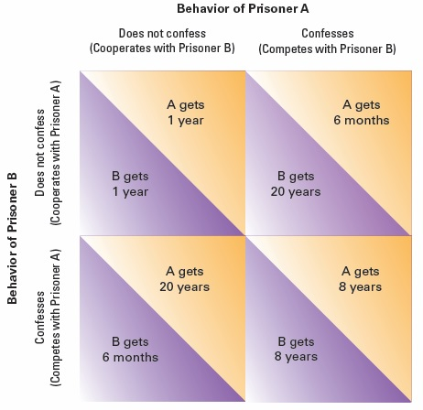
Figure 8.9 The Prisoner’s Dilemma

