Slide 1
Chapter 1: Introducing Social Psychology

Slide 2
Learning Objectives
What do social psychologists study?
How old is the discipline of social psychology?
Why was World War II so important in the development of social psychology in the United States?
What are the most important organizing concepts and perspectives in social psychology?

Slide 3
What is Social Psychology?
Scientific inquiry
Aim: Understand and explain how your thoughts, feelings, and behavior are influenced by the actual, implied, or imagined presence of others.

Slide 4
Examples from Allport's Definition
My thoughts are affected by actual presence of others.
All these students are looking at me. I hope I remember what comes next.
My feelings are affected by imagined presence of others.
As I think about going out later, I'm embarrassed of what my friends might think of these clothes.
My behavior is affected by the implied presence of others
Even if I can't see the TSA agent at the airport, I still don't leave my bag unattended.

Slide 5
More than Common Sense
Sometimes what "everyone knows" is pretty accurate.
Sometimes it isn't.
You really can't tell the difference, relying only on common sense
Social psychology uses science to find the most reliable rules about human thought, emotion, and behavior.

Slide 6
Creating Reality
Self-fulfilling prophecy: You can make a person behave the way you expect that person to behave.
You don't need to know you are doing it.
The other person doesn't need to know you are doing it.
Think about the expectations you hold about others: your roommate, your sibling, your instructor, people from another social group.
Those expectations have power even if you give them very little thought.

Slide 7
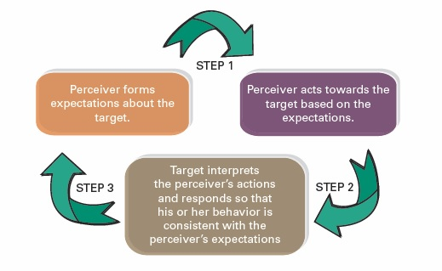
Figure 1.1 The Development of a Self-Fulfilling Prophecy

Slide 8
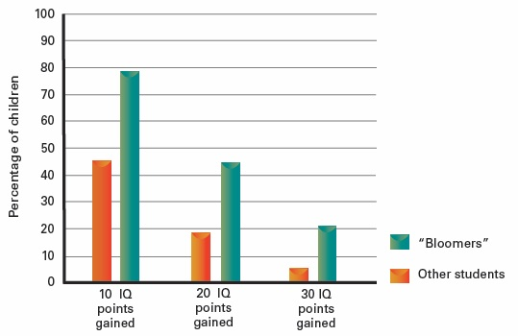
Figure 1.2 Improvement in Schoolchildren's IQ Scores Due to the Self-Fulfilling Prophecy

Slide 9
Psychology and Sociology
Both fields are interested in social behavior.
Psychology: focus on individual-level variables
Thought processes
Emotional reactions
Behavioral tendencies
Sociology: focus on group-level variables
Status
Norms
Social roles

Slide 10
History of Social Psychology
Wilhelm Wundt argued for the development of social psychology in 1862.
Norman Triplett conducts the first social psychological experiment in 1895.

Slide 11
Coming of Age
Floyd Allport's text (1924) emphasized the importance of controlled experimentation.
Society for the Psychological Study of Social Issues founded in 1936
Rise of fascism prompted many leading scholars to emigrate from Europe to the U.S.
One of the most influential: Kurt Lewin

Slide 12
Rapid Expansion
After World War II, research sought answers to problems of the day
Theodor Adorno and Stanley Milgram had influential research programs, searching to explain Nazi atrocities.
Kenneth Clark and Mamie Phipps Clark studied the effect of segregation on the self-concept of black children.
Leon Festinger developed the theory of cognitive dissonance.

Slide 13
Movements in Contemporary Social Psychology
Following "cognitive revolution," a reintegration of affective and motivational processes
More diverse background among researchers
Interest in cross-cultural study
Links with related disciplines

Slide 14
The Self
Social being—develops in interaction with others
Engages in symbolic communication
Has self-awareness—recognizes that the self is separate from others

Slide 15
Self-Serving Bias
Takes credit for success
Why did I get an A on the test? Because I'm so smart, and I worked so hard.
Deny responsibility for failure.
Why did I get an F on the test? Because the test was unfair, and the teacher hates me.

Slide 16
Two Ways of Thinking
Social thinking can be deliberate.
Consciously available
Careful and slow
Requires effort and cognitive resources
Social thinking can be automatic.
Often outside conscious awareness
Quick—uses "rules of thumb"
Effortless and easy

Slide 17
Culture Shapes Social Behavior
United States dominant culture emphasizes uniqueness and individuality.
More of the millennial generation says they are more unique than previous generations.
Also, more tolerant of others' differences than previous generations

Slide 18
Two Key Social Belief Systems
Individualism
Takes care of the self and immediate family only
Pursues one's own goals
Does not like being influenced by group
Collectivism
Takes care of others within your group
Group goals are more important than individual goals.
Accepts group influence
About 70% of the world's population lives in societies with strong collectivist philosophies.

Slide 19
Evolutionary Psychology
Goal: Look for explanations for behavioral universals.
How might these behaviors have enhanced odds of reproductive success?
Remember that individuals don't evolve, populations evolve over many generations.
A trait that may have been adaptive at one point may persist and become maladaptive as the environment changes.

Slide 20
Sex & Gender
Sex
Biological state of being male or female
Your "plumbing"
Gender
Psychological state of being masculine or feminine
Your way of relating to the world

Slide 21
Use of Social Neuroscience
Examines the relationship between social and neural processes
Helps us understand which cognitive processes are involved in specific behavior

Slide 22
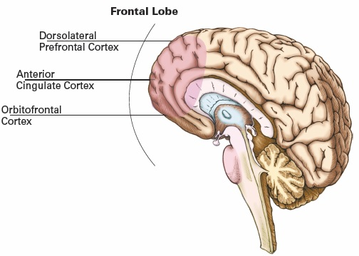
Figure 1.3 Brain Regions in the Frontal Lobe Associated with Self Processes

Slide 23
Positive Psychology
Goals
Enrich human experience
Maximize human functioning
Includes topics such as:
Optimism
Creativity
Morality

