Slide 1
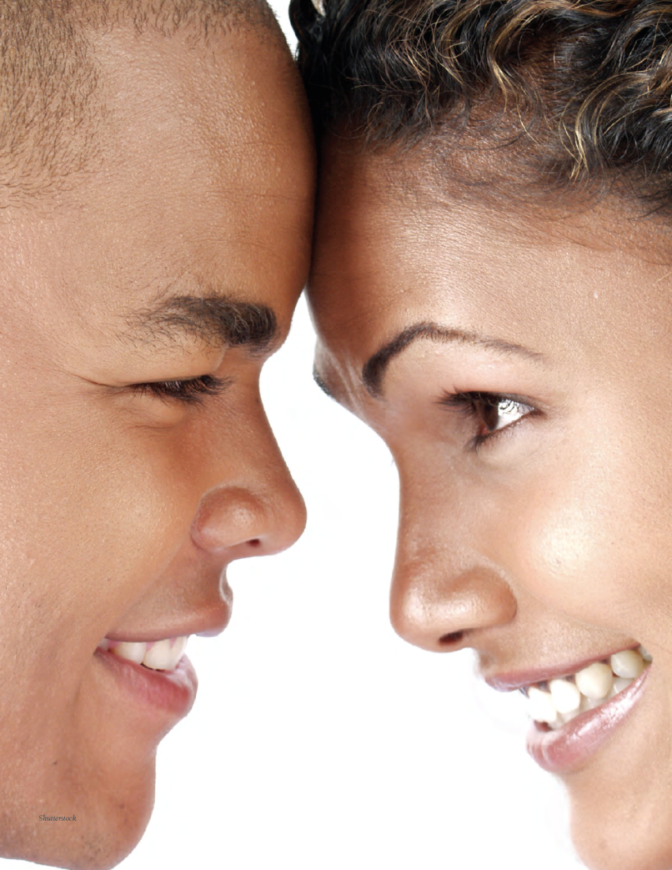
Chapter 14: Understanding Social Behavior

Slide 2
Chapter Outline
Social Perception
Attitudes
Social Influence
Hurting and Helping Others
Interpersonal Attraction and Love

Slide 3
Social Perception (Slide 1 of 5)
Social perception is the way we seek to know and understand other persons and events; also known as social cognition.
The first step in impression formation is to categorize people into groups.
  Impression Formation: the process of integrating various sources of information about a person into an overall judgment

Slide 4
Social Perception (Slide 2 of 5)
Categorizing people into groups can lead to stereotyping.
  Stereotypes: fixed sets of beliefs about people that put them into categories and does not allow for individual variation
  In-group: a group to which we belong and that forms a part of our social identity
  Out-group: any group with which we do not share membership
Physical attractiveness stereotype: the belief that physically attractive individuals possess socially desirable personality traits and lead happier, more fulfilling lives than less attractive persons

Slide 5
Social Perception (Slide 3 of 5)
Prejudice is an attitude and discrimination is an action.
  Prejudice: attitudes towards members of specific groups that directly or indirectly suggest they deserve and inferior social status
  Discrimination: a negative and/or patronizing action toward members of a specific social group
How does intergroup competition cause prejudice?
  Realistic group conflict theory: a theory of prejudice contending that when two groups compete for scarce resources, the competition creates a breeding ground for prejudice
  Ethnocentrism: a pattern of increased hostility toward out-groups, accompanied by increased loyalty to one’s in-group

Slide 6
Social Perception (Slide 4 of 5)
Is there such a thing as unconscious prejudice?
What might explain some racial misunderstandings and conflicts?
How is sexism differently expressed?
Can we control and eliminate our prejudicial attitudes?

Slide 7
Social Perception (Slide 5 of 5)
Explaining people’s behavior hinges on either internal or external attributions.
  Attribution: the process by which people use information to make inferences about the causes of behaviors or events
  Internal attribution: locates the cause of an event as factors internal to the person, such as personality traits, moods, attitudes, abilities, or effort
  External attribution: locates the cause of an event as factors external to the person, such as luck, other people, or the situation

Slide 8
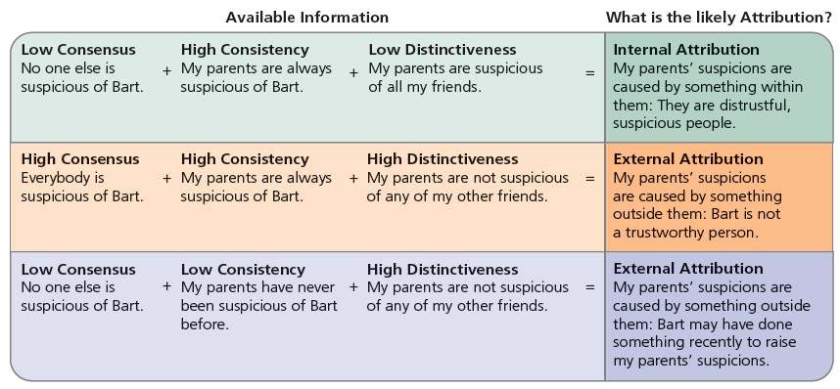
Figure 14-2: Why Did My Parents React Negatively to My Spending Time with Bart Simpson?

Slide 9
Attitudes (Slide 1 of 3)
Attitudes: positive or negative evaluations of objects
Two common attitude shapers are repeated exposure and conditioning.
  More exposure effect: the tendency to develop more positive feelings toward objects and individuals the more frequently we are exposed to them

Slide 10
Attitudes (Slide 2 of 3)
People take one of two cognitive routes in processing persuasive messages.
  Persuasion: the process of consciously attempting to change attitudes through the transmission of some message
  Elaboration likelihood model: theory that there are two ways in which persuasive messages can cause attitude change, each differing in the amount of cognitive effort or elaboration they require

Slide 11
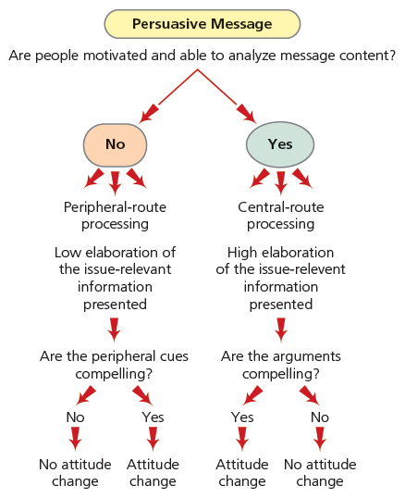
Figure 14-4: Two Routes to Persuasion

Slide 12
Attitudes (Slide 3 of 3)
The need for cognitive consistency can lead to attitude change.
  Cognitive dissonance: a feeling of discomfort caused by performing an action inconsistent with one’s attitudes

Slide 13
Social Influence (Slide 1 of 3)
Social influence: the exercise of social power by a person or group to change the attitudes or behavior of others in a certain direction
Asch’s research demonstrates the power of conformity pressure.
  Conformity: a yielding to perceived group pressure

Slide 14
Social Influence (Slide 2 of 3)
Factors that influence conformity:
  Group size
  Group cohesiveness
  Social support
  Desire for personal control
  Culture

Slide 15
Social Influence (Slide 3 of 3)
Compliance is influenced by mood, reciprocity, and reason-giving.
  Compliance: publicly acting in accord with a direct request
  Reciprocity norm: the expectation that one should return a favor or a good deed
Milgram’s research demonstrates that people often obey destructive orders.
  Obedience: the performance of an action in response to a direct order

Slide 16
Hurting and Helping Others (Slide 1 of 3)
Aggression: any form of behavior that is intended to harm a person, oneself, or an object
Aggression involves the intention to harm.
  Instrumental aggression: the intentional use of harmful behavior in order to achieve some other goal
  Hostile aggression: the intentional use of harmful behavior with the goal of causing injury or death to the victim

Slide 17
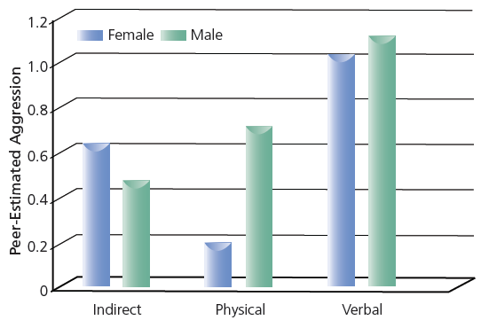
Figure 14-7: Gender Comparisons in Aggressive Strategies

Slide 18
Hurting and Helping Others (Slide 2 of 3)
Aggressive impulses can be modified by higher-order thinking.
  Cognitive-neoassociationist mode: a theory of aggression stating that aversive events produce negative affect, which stimulates the inclination to aggress

Slide 19
Hurting and Helping Others (Slide 3 of 3)
Helping others is largely a learned response.
Deciding to help often involves a series of decisions.
  Audience inhibition effect: a situation in which people are inhibited from helping due to a fear of being negatively evaluated by other bystanders if they do intervene and it turns out not to be an emergency
  Diffusion of responsibility: the belief that the presence of others is a situation makes one less personally responsible for events that occur in that situation

Slide 20
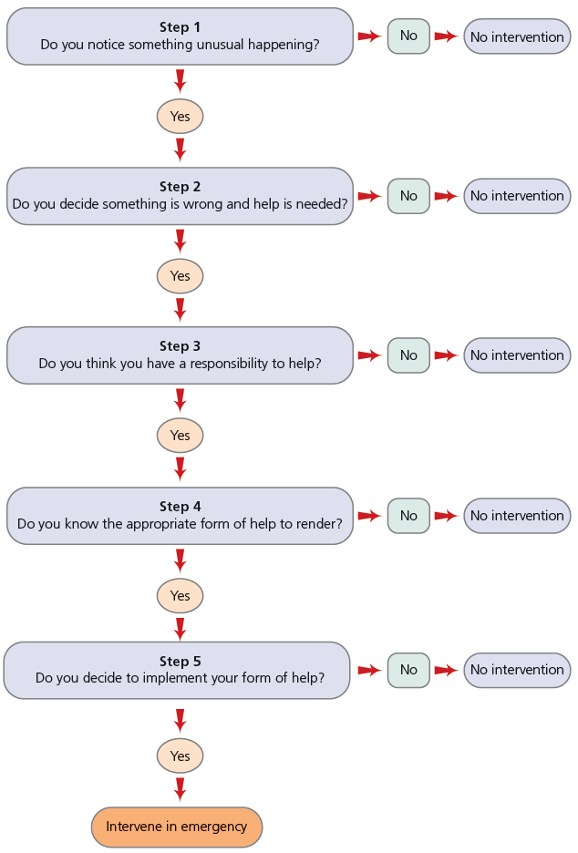
Figure 14-9: The Model of Bystander Intervention: A Five-Step Decision Process

Slide 21
Interpersonal Attraction and Love
(Slide 1 of 3)
Proximity and similarity often lead to attraction
  Matching hypothesis: the proposition that people are attracted to others who are similar to them in certain characteristics, such as attitude and physical attractiveness
  Balance theory: the theory that people desire cognitive consistency, or “balance,” in their thoughts, feelings, and social relationships

Slide 22
Interpersonal Attraction and Love
(Slide 2 of 3)
Romantic love consists of both passionate and compassionate love.
  Passionate love: a state of intense longing for union with another that we typically experience most intensely during the early stages of a romantic relationship
  Companionate love: the affection we feel for those with whom our lives are deeply entwined

Slide 23
Interpersonal Attraction and Love
(Slide 3 of 3)
The relationship between love and marriage differs across cultures.
Positive illusions and “mind reading” increase romantic satisfaction.
People use four strategies to handle relationship conflict.
  Exit
  Voice
  Neglect
  Loyalty

Slide 24
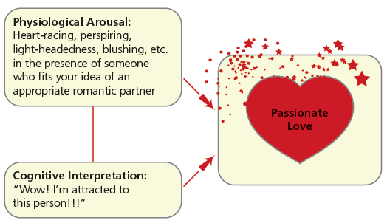
Figure 14-10: The Two-Factor Theory of Emotion and Passionate Love

