Slide 1
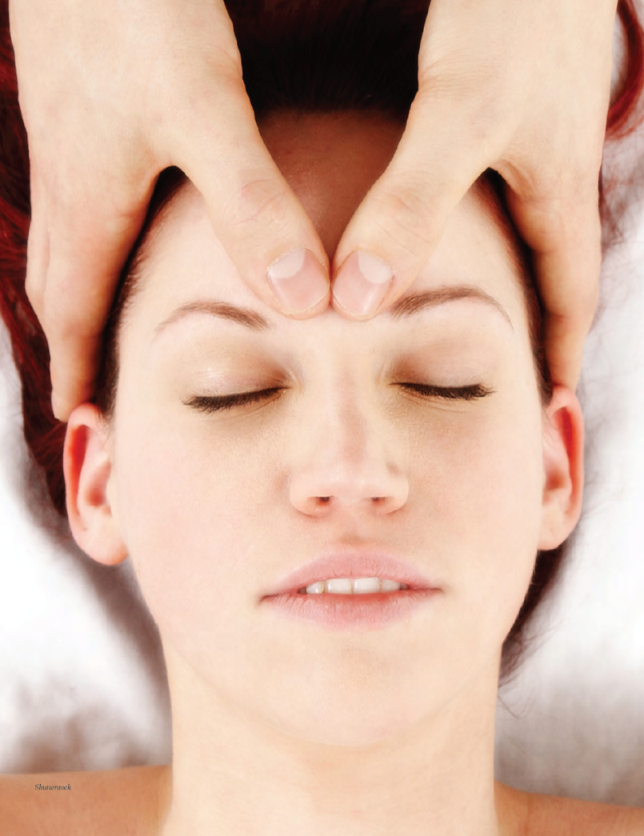
Chapter 13: Stress, Coping, and Health

Slide 2
Chapter Outline
What causes stress?
What moderates stress?
What behaviors hurt or help our health?

Slide 3
Learning Objectives
Understand the different causes of stress.
Understand the different factors that cane moderate stress.
Understand behaviors that can hurt and help our health.

Slide 4
What Causes Stress?
Stress: one’s response to events that disturb or threatens to disturb our physical or psychological equilibrium
Stressors: external or internal events that challenge or threaten us
Stressors can be negative or positive events.
  Romantic relationship ending
  Wedding
  Illness

Slide 5
Stress Reactions (1)
Hans Selye (1907-1982) studied how our bodies react to stress. He found that our bodies have a stress response to any significant demand on the body.
General adaptation syndrome: body’s response to to stress
  Consists of the following three stages:
    Alarm
    Resistance
    Exhaustion

Slide 6
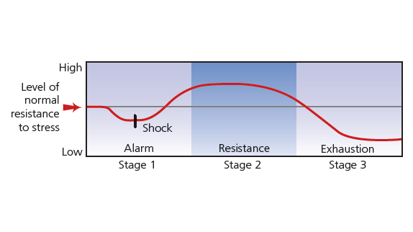
Figure 13-1: General Adaption Syndrome

Slide 7
Stress Reactions (2)
During the alarm stage, the hypothalamus sends messages along a neural pathway signaling the adrenal glands to release epinephrine and norepinephrine, which heightens arousal.
If the threat persists, the hypothalamus signals the pituitary gland, which signals the adrenal gland to secrete cortisol and other hormones.

Slide 8
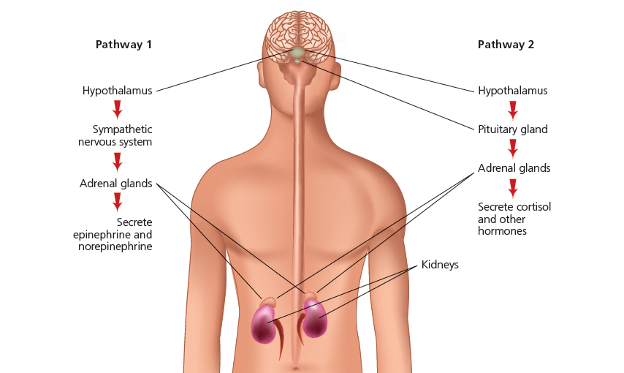
Figure 13-2: Two Stress Pathways

Slide 9
Fight or Flight Stress Response
Males are more likely to use fight or flight.
Females are more likely to tend-and-befriend.
  May be due to higher levels of oxytocin.
Evolutionary theorists believe these differences are due to different mating strategies.
Another explanation may be gender socialization

Slide 10
Psychophysiological Illness
Psychophysiological disorders: physical conditions that are caused or aggravated by psychological factors, such as stress
  High blood pressure can occur due to increased sympathetic nervous system activity, placing more strain on the cardiovascular system.
Psychoneuroimmunology: field that studies the relationship between psychological factors and physical illness
  Immune system problems can arise when stress is prolonged.
  Chronic stress reduces the efficiency of the immune system.

Slide 11
Cognitive Appraisal of Stress
Problem-focused coping: strategy to reduce stress by overcoming the source of the problem (e.g., If you fail an exam, what can you do?)
Emotion-focused coping: strategy to manage emotional reactions to stress instead of trying to change the stressor (e.g., leisure activities)

Slide 12
Predictability and Control
Perceived control over a stressor is an important factor in moderating stress.
The following are differences in perceived control:
  Internal locus of control
  External locus of control
Procrastination can increase stress symptoms.

Slide 13
Hostile Persons and Stress
Type A behavior pattern: characterized by competitiveness, impatience, ambition, hostility and a hard-driving approach to life
Type B behavior pattern: characterized by a patient, relaxed, easygoing approach to life
Which type do think causes an over arousal of the body’s stress responses?

Slide 14
Pessimism and Stress
Pessimistic explanatory style explains uncontrollable negative events as being caused by internal factors
  “It’s my fault.”
Optimistic explanatory style explains uncontrollable negative events as being due to external factors
  “It’s not my fault.”
Optimists live longer and have better immune systems.
Pessimists have a higher risk of untimely death.

Slide 15
Other Influences on Stress
Social support can increase life expectancy.
Social support also can increase our knowledge about stressors—we can talk about them.
People who attend religious services have been found to live longer.
  The following are two explanations for this:
    Healthier lifestyles
    Social support

Slide 16
Stress and Internal and
External Forces
Obesity can be caused by internal and external factors.
Eating disorders can be caused by internal and external factors.
Exercise can increase physical and mental health.
Relaxation training can reduce stress.

