Slide 1

Chapter 9: Motivation and Emotion

Slide 2
Chapter Outline
Motivation
Hunger and Eating
Sexual Motivation
Belongingness and Achievement Motivation
Emotion

Slide 3
Learning Objectives
Understand that genes may shape our motivation.
Understand the mechanisms that control hunger and eating.
Understand that people differ in their need to seek the company of others.
Understand how gender can shape the social meaning of emotion.

Slide 4
Motivation
Motivation is an inner state that energizes behavior toward the fulfillment of a goal.
  Motivation is a dynamic process that is not easily measured or quantified.
Theories focus on what internal and external forces influence behavior.
Instinct: an unlearned, relatively fixed pattern of behavior that is essential to survival

Slide 5
Reduce Arousal
Drive-reduction theory: An imbalance in homeostasis creates a physiological need, which produces a drive that motivates one to satisfy it.
Homeostasis: tendency for organisms to keep physiological systems balanced by adjusting them in response to change
Drive: a physiological state of arousal that moves an organism to meet a need

Slide 6
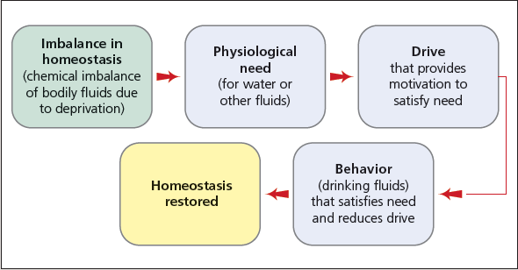
Figure 9-1: Drive-Reduction Theory

Slide 7
Optimal Level of Arousal
Yerkes-Dodson law: the idea that we perform best when we are at an intermediate level of arousal
  People differ in their optimal level of arousal.
  It can be high or low.
Can you give examples of high and low arousal level activities?

Slide 8
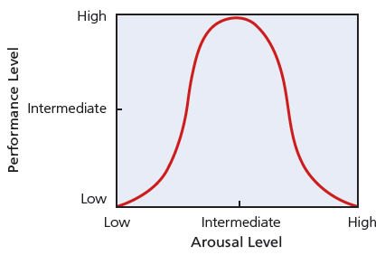
Figure 9-2: The Yerkes-Dodson Law

Slide 9
External Factors Motivate Behavior
Incentive theory: Behavior is directed toward attaining desirable stimuli and avoiding undesirable stimuli.
Incentive: a positive or negative environmental stimulus that motivates behavior
Intrinsic motivation: motivation to engage in a behavior because one finds it enjoyable for its own sake
Extrinsic motivation: motivation to engage in a behavior because of external rewards
  Extrinsic motivators can increase or decrease task enjoyment.

Slide 10
Rewards and Intrinsic Motivation
Rewards can affect the quality of work.
Rewards should be given because specific performance standards have been met or surpassed.
Tangible rewards are more likely to undermine intrinsic motivation than verbal praise.

Slide 11
Hierarchy of Needs
Abraham Maslow
Hierarchy of needs: the needs that are most basic and must be sufficiently satisfied before higher-level safety needs and psychological needs become activated
Self-actualization: the ultimate goal of growth—the realization of one’s full potential

Slide 12
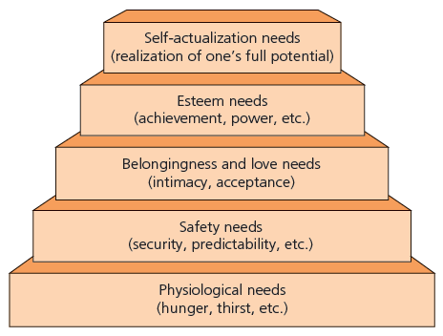
Figure 9-3: Maslow’s Hierarchy of Needs

Slide 13
Hunger and Eating
These are the three major control systems of hunger.
  Stomach
  Bloodstream
  Brain
The stomach releases the hormone gastrin that decreases appetite.
There are two types of blood signals.
  Food nutrients
  Hormone levels
Hypothalamus: the mechanism that turns hunger on and off

Slide 14
Social Factors and Hunger and Eating
How you think about food also affects your eating behavior.
  Restrained eater: chronically worried about and trying to control what and how much they eat
  Unrestrained eater: relatively unconcerned about controlling their eating
Restrained eaters are more likely to gain weight. Why?

Slide 15
Sexual Motivation
Alfred Kinsey’s (1940s) sexual behavior research
Sexual script: preconception about how a series of events, perceived as sexual, is likely to occur
  Learned from social environments
  North American sexual script: women downplay interest in sex and men freely express sexual interest
  Gender differences reflect different evolutionary pressures.
Rape myth: false belief that women enjoy forced sex

Slide 16
Sex and Love May Be More
Fused for Women
Sexual desire and romantic love have evolved to meet different needs.
  Sexual mating system
  Attachment
Evolutionary and sociocultural factors may shape sexuality.

Slide 17
Sexual Orientation
Sexual orientation: degree to which a person is sexually attracted to persons of the other sex and/or the same sex
Sexual identity: the identity a person organizes around his or her sexual orientation
Kinsey designed a seven-point scale to describe sexual orientation as a continuum.

Slide 18
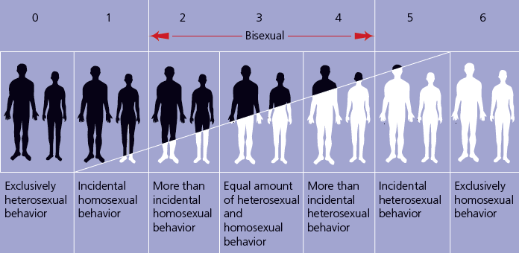
Figure 9-5: Sexual Orientation as a Continuum

Slide 19
Causes of Sexual Orientation Unclear
What causes sexual orientation?
  Brain development
  Genes
  Gender nonconformity

Slide 20
Belongingness and
Achievement Motivation
Need to belong: need to interact with others and be socially accepted
  Evolutionary explanation
  High need to belong vs. low need to belong
Need for achievement: desire to overcome obstacles and meet high standards of excellence
Thematic Apperception Test: a test in which people project their inner feelings and motives through the stories they make up about ambiguous pictures

Slide 21
Emotions
Emotions: a positive or negative state that typically includes some combination of physical arousal, cognitive appraisal, and behavioral expression
Evolutionary theories emphasize the values of emotion.
  Avoid harm.
  Approach what is beneficial.
  Foster communication with others.

Slide 22
Emotions Facilitate Survival
There are seven primary emotions.
  Anger
  Disgust
  Fear
  Happiness
  Surprise
  Contempt
  Sadness
Can be read across cultures
Collectivism influences whether people publicly express negative feelings, not feel them.

Slide 23
Emotions and Bodily Responses
Body responses to emotion are produced by autonomic nervous system.
  Sympathetic
  Parasympathetic
Emotional fainting can be an overreaction by the parasympathetic system.
Polygraph: measures several of the physiological responses accompanying emotion (respiration, heart rate, BP, and palm perspiration)

Slide 24
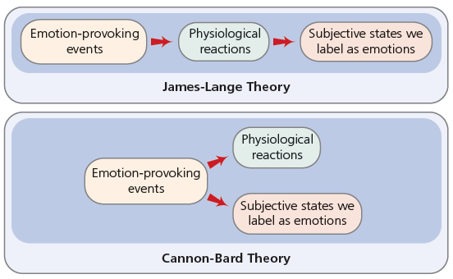
Figure 9-8: Two Contrasting Theories of Emotion

Slide 25
Two Contrasting Theories of Emotion
James-Lange theory: emotion-provoking events induce specific physiological changes in the ANS; body reacts before you feel fear
Cannon-Bard theory: emotion-provoking events simultaneously induce both physiological responses and emotions; happens at the same time
Facial feedback hypothesis: specific facial expressions trigger emotional responses

