Slide 1

Chapter 2: Neurological and Genetic Basis of Behavior

Slide 2
Chapter Outline
The Neuron
Neural and Hormonal Systems
The Brain
Genetic Influences on Behavior

Slide 3
The Neuron (Slide 1 of 5)
Neurons are the nervous system’s building blocks.
  Neurons: specialized cells in the nervous system that sends and receives information
  Sensory neurons: neurons that send information from sensory receptors to the brain, usually by way of the spinal cord
  Motor neurons: neurons that send commands from the brain to glands, muscles, and organs to do, cease, or inhibit something
  Interneurons: neurons that connect the sensory neurons’ input signals with the motor neurons’ output signals

Slide 4
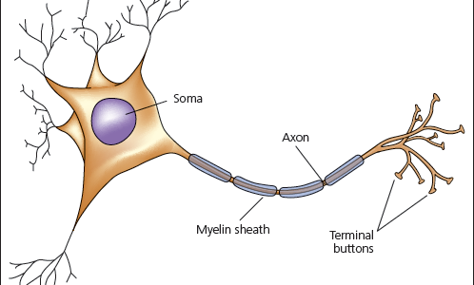
Figure 2-1: Structure of a Neuron

Slide 5
The Neuron (Slide 2 of 5)
A neuron consists of a soma, dendrites, and an axon.
  Soma: the cell body of the neuron which contains the nucleus and other components that preserve and nourish it
  Dendrites: branchlike extensions of the soma that receive information from other neurons
  Axon: an extension of the soma that sends information in the form of electrochemical impulses to other neurons

Slide 6
The Neuron (Slide 3 of 5)
Myelin sheath: a protective coating of fatty material around an axon that hastens the transmission of the electrochemical charge
Synapse: the entire area composed of the terminal button of one neuron, the synaptic cleft, and the dendrite of another neuron
Glial cells: non-neuron cells that supply the neurons with support, nutrients, and insulation

Slide 7
The Neuron (Slide 4 of 5)
A neuron is in either a resting or a firing state.
  Resting potential: the stable, negative charge of an inactive neuron
  Action potential: the brief shift in a neuron’s electrical charge that travels down the axon
Neurons communicate with one another by releasing chemicals.
  Neurotransmitters: chemical messengers released by the synaptic vesicles that travel across the synaptic cleft and either excites or inhibits adjacent neurons

Slide 8
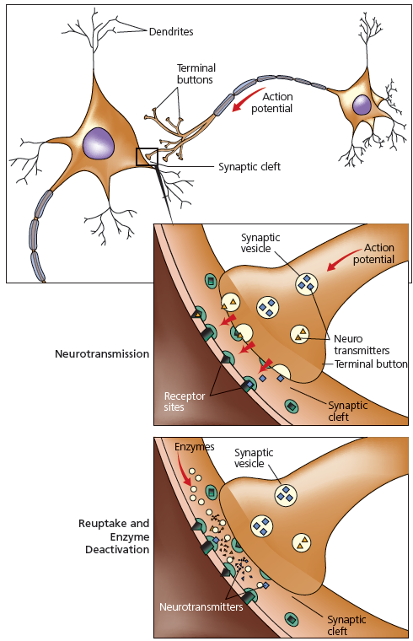
Figure 2-3: Synaptic Transmission

Slide 9
The Neuron (Slide 5 of 5)
Major neurotransmitters
  Acetylcholine (Ach): involved in muscle contraction and memory formation
  Dopamine (DA): promotes and facilitates movement as well as influencing thought and emotion
  Endorphins: similar to morphine and play an important role in the experience of pleasure and the control of pain
  Serotonin: important in regulating emotional states, sleep cycles, dreaming, aggression, and appetite

Slide 10
Neural and Hormonal Systems (Slide 1 of 5)
The peripheral nervous system connects the brain and spinal cord with body organs and tissues.
  Peripheral nervous system: that portion of the nervous system containing all the nerves outside the brain and spinal cord
  Nerve: a bundle of axons from many neurons that are routed together in the peripheral nervous system

Slide 11
Neural and Hormonal Systems (Slide 2 of 5)
Somatic nervous system: transmits commands to the voluntary skeletal muscles and receives sensory information from the muscles and the skin
Autonomic nervous system: controls the movement of non-skeletal muscles, such as the heart and lung muscles, over which people have little or no voluntary control
Sympathetic nervous system: the part of the autonomic nervous system that activates the body’s energy resources to deal with threatening situations
Parasympathetic nervous system: the part of the autonomic nervous system that acts to conserve and maintain the body’s energy resources

Slide 12
Neural and Hormonal Systems (Slide 3 of 5)
The spinal cord connects the peripheral nervous system to the brain.
  Central nervous system: that portion of the nervous system located in the bony central core of the body. consisting of the brain and spinal cord
  Cerebrospinal fluid: a clear, cushioning fluid secreted by the brain and circulated inside and around the brain and spinal cord
  Spinal cord : that slender, tube-shaped part of the central nervous system that extends from the base of the brain down the center of the back made up of a bundle of nerves

Slide 13
Neural and Hormonal Systems (Slide 4 of 5)
The endocrine system communicates by secreting hormones.
  Endocrine system: a network of glands in various parts of the body that manufactures and secretes hormones directly into the blood stream
  Hormones: chemical signals, manufactured and secreted into the blood by the endocrine glands
  Pituitary gland: the body’s “master” gland, located in the base of the brain, whose hormones stimulate and regulate the rest of the endocrine system

Slide 14
Neural and Hormonal Systems (Slide 5 of 5)
Thyroid gland: the gland located just below the larynx in the neck that controls metabolism
Adrenal glands: two glands, located near the kidney, that secrete epinephrine and norepinephrine, which activate the sympathetic nervous system
Gonads: the two sex glands, called ovaries in females and testes in males

Slide 15
The Brain (Slide 1 of 5)
Modern technology measures the brain’s electrical activity, structure, blood flow, and chemistry.
  Electroencephalograph (EEG)
  Computerized axial tomography (CAT)
  Magnetic resonance imaging (MRI)
  Positron emission tomography (PET)
  Functional magnetic resonance imaging (fMRI)

Slide 16
The Brain (Slide 2 of 5)
Three major brain regions are the hindbrain, midbrain, and forebrain.
  Hindbrain: the region of the brain above the spinal cord that contains the medulla, the pons, and the cerebellum
  Midbrain: the region of the brain above the hindbrain that contains the reticular formation
  Forebrain: the region of the brain above the midbrain that contains the cerebral cortex, thalamus, hypothalamus, and limbic system

Slide 17
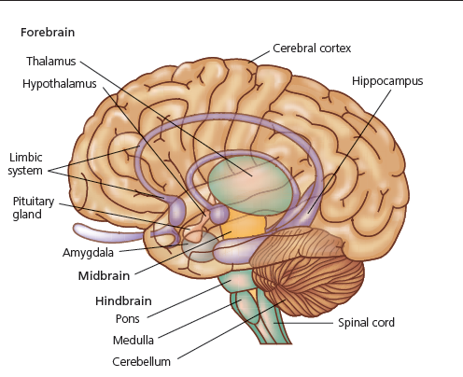
Figure 2-7: Main Parts of the Human Brain

Slide 18
The Brain (Slide 3 of 5)
The cerebral cortex is the crowning achievement of human evolution.
  Cerebral cortex: the largest structure in the forebrain, largely responsible for higher order mental processes
The cerebral cortex consists of specialized regions, or “lobes.”
  Occipital lobe
  Parietal lobe
  Temporal lobe
  Frontal lobe

Slide 19
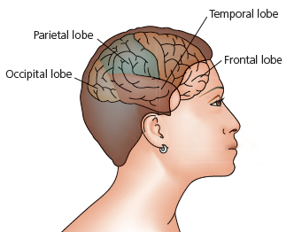
Figure 2-10: The Lobes of the Cerebral Cortex

Slide 20
The Brain (Slide 4 of 5)
The right and left cerebral hemispheres function differently.
  Cerebral lateralization: the degree to which the right or left hemisphere controls various cognitive and behavioral functions
Are there “left-brain” and “right-brain” people?
Are there sex differences in hemispheric organization?

Slide 21
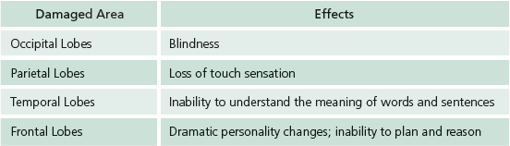
Figure 2-3: Possible Consequences of Damage to Different Areas of the Cerebral Cortex

Slide 22
The Brain (Slide 5 of 5)
The brain can alter its neural connections.
  Plasticity: the ability of the brain to alter its neural connections following damage

Slide 23
Genetic Influences on Behavior (Slide 1 of 4)
Phenotype: the visible and measurable traits of an organism
Genotype: the underlying genetic composition of an organism

Slide 24
Genetic Influences on Behavior (Slide 2 of 4)
Gene: the basic biochemical unit of inheritance that is located on and transmitted by chromosomes
Chromosomes: thread-like structures carrying genetic information that are found in every cell of the body
Deoxyribonucleic acid: the complex molecule strand of the chromosome that contains thousands of different genes, located at fixed positions
Sex chromosomes: one of the 23 pairs of chromosomes that determines whether an individual is male of female

Slide 25
Genetic Influences on Behavior (Slide 3 of 4)
Both heredity and environment influence physical and behavioral traits.
  Behavior genetics: the study of how the genotype and the environment of an organism influence its behavior
Molecular genetics seeks to identify specific genes that influence behavior.
  Molecular genetics: the sub-discipline in biology that studies the molecular structure and function of genes to determine how they influence behavior

Slide 26
Genetic Influences on Behavior (Slide 4 of 4)
Controversies surround genetic explanations of certain sex and race differences.
  Sex: the biological status of being female of male
  Gender: the meaning that societies and individuals attach to being female and male
Does race tell us anything useful about how people differ genetically?

