Slide 1
Chapter 11: Aggression

Slide 2
Learning Objectives
Do women and men differ in the types of aggression they tend to express?
Can you reduce people's aggression by encouraging them to "blow off steam" when angry?
Why might laws allowing concealed guns significantly increase gun-related violence?
How do traditional sexual scripts promote date rape?

Slide 3
Aggression Defined
Any form of behavior intended to harm someone or something
Intent is hard to verify, but important to the definition.
Acts intended to harm one's self are aggressive.
Assertiveness (the ability to assert your rights) is not aggression.
No harm or violation of others' rights

Slide 4
Instrumental Aggression
Also known as proactive aggression
Aggression as a means to an end
Generally a "cool" or rational decision
Includes aggression carried out to avoid punishment
Most bullies fit into this category.

Slide 5
Hostile Aggression
Also known as reactive aggression
Triggered by anger
No other goal than to cause pain or damage
Generally impulsive; "hot"
Sarcastic humor is a kind of hostile aggression.

Slide 6
Gender and Aggression
Men engage in more physical aggression than women.
Women view physical aggression as a loss of self-control.
Men view physical aggression as exerting control.
There are few gender differences in verbal aggression.
Women are more likely to use indirect than direct aggression.

Slide 7
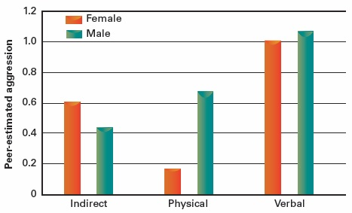
Figure 11.1 Gender Comparisons in Aggressive Strategies

Slide 8
Personality and Aggression
Three traits associated with aggression:
Irritability
Rumination
Emotional susceptibility
Unstable high self-esteem can produce aggressive responses.
Aggression-prone individuals focus on immediate not long-term consequences.

Slide 9
Intergroup Aggression
Often more severe than interpersonal aggression
Reasons
Realistic group conflict escalates hostility.
Groups delegitimize members of other groups.
Group polarization causes extreme views and behavior.
Collective aggression has negative consequences for the aggressor nation as well as for the victims.

Slide 10
Evolution and Aggression
Aggression can be seen as an adaptive response in many species.
Aggressive males gain sexual access to females.
Aggression secures resources.
Aggression aids the survival of the group.
Levels of aggression vary widely among cultures.
Culture can shape evolutionary impulses.

Slide 11
Human Biology and Aggression
Studies of twins show that individual aggression has an inherited component.
Environment also plays a major role.
Testosterone is clearly linked to human aggression.
Low levels of serotonin can impede the ability to inhibit aggressive responses.

Slide 12
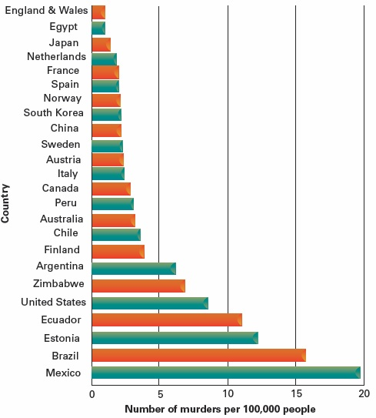
Figure 11.2 Annual Murder Rates Around the Globe

Slide 13
Frustration-Aggression Hypothesis
Early formulation
All frustration leads to aggression.
All aggression comes from frustration.
Aggression results in catharsis.
Current thinking
Frustration often leads to aggressive impulses, especially when the frustration seems intentional and unfair.
If aggression can be delayed, it is less likely to occur.

Slide 14
Catharsis
The common belief is that you can "vent" your anger and get rid of it. This is not supported by research.
Indirect venting does not appear to reduce aggression.
Direct venting (against the person who caused your frustration) increases aggression.
Despite the evidence, people continue to believe in catharsis.

Slide 15
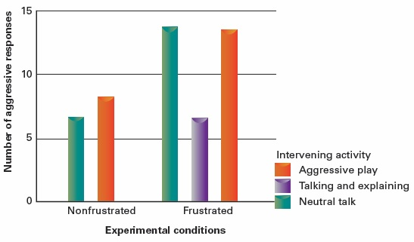
Figure 11.3 Does Children’s Aggressive Play Have a Cathartic Effect?

Slide 16
Unpleasant Situations
Negative emotions can become encoded with thoughts and reflexive behaviors.
Aversive situations can increase the urge for both "fight" and "flight."
Impulsive reactions can result
Although higher-order thinking can change the result
Hot temperatures increase aggression.
Aggressive cues can trigger aggression.

Slide 17
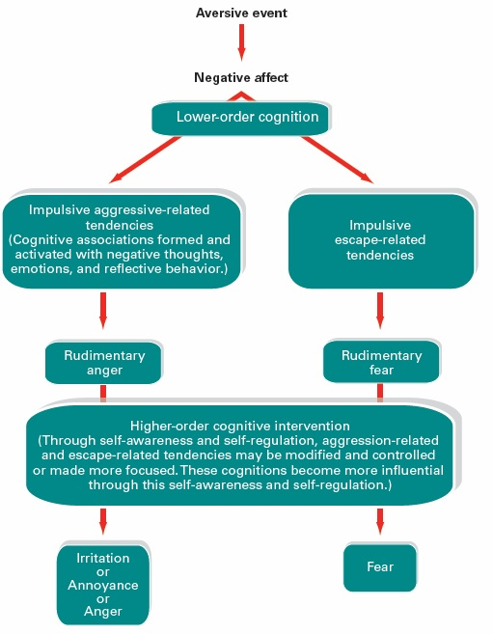
Figure 11.4 Cognitive-Neoassociation Model of Hostile Aggression

Slide 18
Alcohol and Aggression
Alcohol is involved in about 50% of violent crimes.
Alcohol reduces:
Inhibitions against aggression
Attention to personal and social standards
People are expected to behave a certain way when drunk.
Self-fulfilling prophecy for inappropriate behavior

Slide 19
Excitation Transfer
As with attraction, physical arousal can increase aggression.
Stimuli that have produced increased aggression in studies include:
Physical exercise
Loud noise
Vigorous music
Violent movies
Sexual imagery

Slide 20
Social Learning Theory
Behavior that is rewarded is likely to recur.
People learn by watching that for which others are rewarded.
Children are most likely to model the behavior of those they are close to and those with authority.
Thus, children imitate aggressive acts if those who commit them seem to gain rewards.
Observation of aggressive acts can generate aggressive scripts for handling problems.

Slide 21
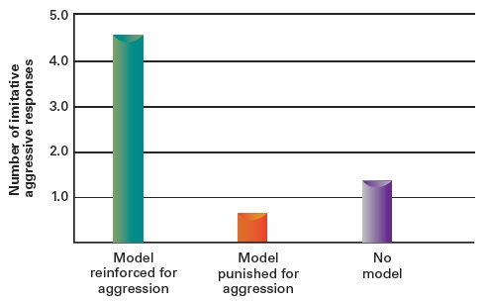
Figure 11.5 Modeling Aggression as a Function of Reinforcement and Punishment

Slide 22
Media Violence
Yes, violent television and movies do increase violent behavior.
In both the short-term and the long-term
Yes, music with violent lyrics does increase aggressive thinking and behavior.
Yes, playing violent video games produces increased tendencies toward violence.

Slide 23
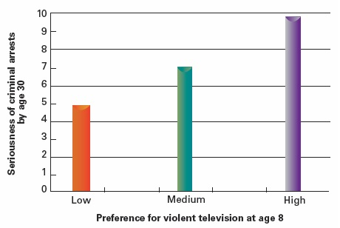
Figure 11.6 Childhood Preference for Violent Television and Later Aggressive Behavior

Slide 24
Media Coverage and Copycat Violence
The tendency for sensational publicity about violent murders or suicides to result in more of the same through imitation
Observational Learning
Deindividuation
One form of copycat violence is copycat suicide.
The media spotlight confers a sense of prestige.

Slide 25
Culture of Honor
Develops in "lawless" societies where authorities cannot provide protection
e.g., more common in ranching-based economy than farming because livestock can be stolen
Honor is the most valued personal quality.
Insults must be met with an aggressive response.
Usually co-occurs with strong norms of politeness

Slide 26
Pornography and the "Rape Myth"
Pornography = sexual material + abuse or degradation
The rape myth is the false belief that women enjoy forcible sex.
Media showing sexual aggression increased male viewers' endorsement of rape myth.
Media does need to be "hardcore" to have this effect.

Slide 27
Pornography and Aggression
In lab studies, exposure to violent pornography increases aggression against a female confederate.
When male subjects had been angered by the confederate
When the pornography contained a message that women enjoy the violence
In correlational studies, the amount of available pornography does not correlate with rape rates.

Slide 28
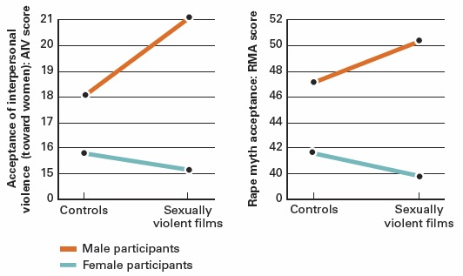
Figure 11.7 The Effects of Mass Media Exposure on Acceptance of Violence Against Women

Slide 29
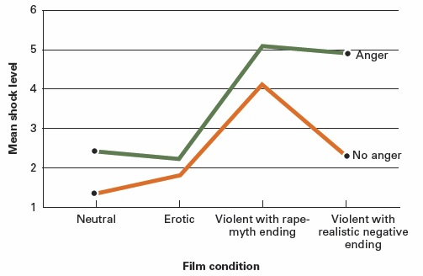
Figure 11.8 How Does the Film Victim’s Reaction to Rape Affect Male Viewers’ Subsequent Level of Aggression Toward Women?

Slide 30
Acquaintance Rape
On college campuses, 85% of sexual assaults are committed by an acquaintance.
Sexual scripts that make date rape more likely:
Resistant female role
Predator male role
Sexual dominance is a more important motive than sexual gratification.

Slide 31
Punishing Aggression
Punishment can reduce aggression when it is:
Prompt
Relatively strong
Consistently applied
Even under these circumstances, punishment may be ineffective
May produce more anger
May model violent behavior

Slide 32
Other Ways to Reduce Aggression
Induce incompatible responses (e.g., laughter)
Model nonaggressive behavior
Internalize anti-aggression beliefs
Offer apologies
Improve social skills
Negotiation
Conflict resolution
Cooperative problem solving
Reduce exposure to violent media

