Slide 1
Chapter 6: Stereotypes, Prejudice, and Discrimination

Slide 2
Learning Objectives
What purpose does stereotyping serve as a cognitive process for humans?
What is modern racism?
Why do social scientists contend that sexism has both a hostile side and a benevolent side?
Can prejudice be reduced, or is it so ingrained in our species’ evolutionary heritage that it is impossible to reduce?

Slide 3
Intergroup Attitudes
Using tricomponent model of attitudes when dealing with a social outgroup
Cognitive component—stereotype
Affective/evaluative component—prejudice
Behavioral component—discrimination
Ingroup: a group to which one belongs; us
Outgroup: a group to which one does not belong; them

Slide 4
Outgroup Homogeneity Effect
“They” are all the same, but “we” are a collection of unique individuals.
We process information about outgroups less thoroughly than information about ingroups.
Rely more on heuristics
Can be reversed when ingroup membership is an important part of social identity

Slide 5
Stereotypes
Beliefs about social groups
Assumption about members of the group that does not allow for individual variation
Learned from others
Maintained through experience
A type of schema
Can be activated automatically
Can affect behavior without conscious awareness

Slide 6
Function of Stereotyping
Type of heuristic
Allows for fast judgments
Frees cognitive resources for other tasks
Because stereotyped thinking is fast and efficient, it is often used.
Causes people to ignore information that does not fit the stereotype

Slide 7
Illusory Correlation
Belief that two things are related when they are not
Can support stereotyped thinking
Formed when:
Perceiver already assumes the relationship exists
When two unusual events co-occur

Slide 8
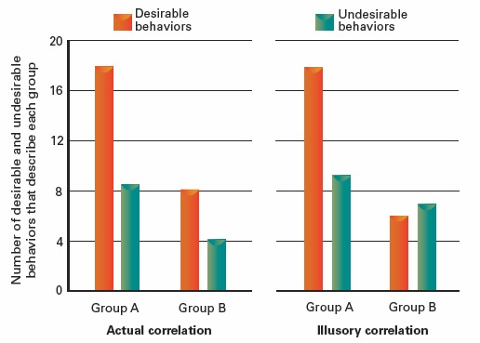
Figure 6.1 Illusory Correlations and the Persistence of Stereotypes

Slide 9
Stereotype Contents
Though stereotyped thinking can lead to incorrect judgments, it can also lead to accurate judgments.
Contents of the stereotype are more about the relationship between groups than about the groups themselves.

Slide 10
Prejudice
Attitude toward a group suggesting they deserve inferior status
Explicit and/or implicit
Explicit nonprejudiced attitudes may coexist with implicit prejudiced attitudes.
Implicit prejudice is harder to change than explicit.

Slide 11
Discrimination
Negative and/or patronizing action toward outgroup member
As attitudes do not always predict behavior, prejudice does not always predict discrimination.
People may discriminate without being aware of it.

Slide 12
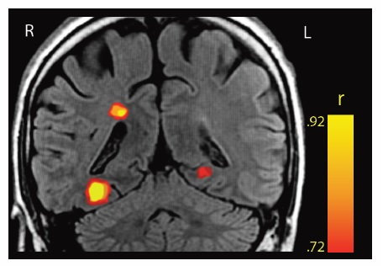
Figure 6.2 Measuring Implicit Prejudice Using Brain Scans

Slide 13
Three Forms of Prejudice
Based on two factors
Competition vs. cooperation
Social status
Low status + competition → contemptuous prejudice
High status + competition → envious prejudice
Low status + cooperation → paternalistic prejudice

Slide 14
Stigma
Attribute that discredits person/group in the eyes of others
Goffman’s categories of stigma
Tribal identities
Blemishes of individual character
Abominations of the body

Slide 15
Racism
Prejudice/discrimination based on racial background
“Old fashioned,” overt racism has declined in American society.
Afrocentric appearance evokes implicit racial stereotypes in many societies.

Slide 16
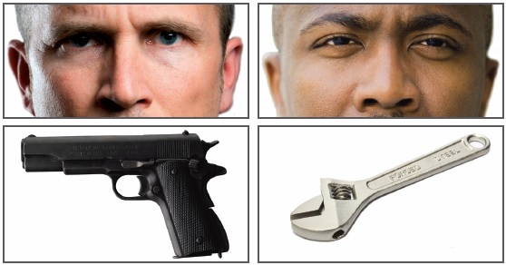
Figure 6.3 Race and the Misperception of Weapons

Slide 17
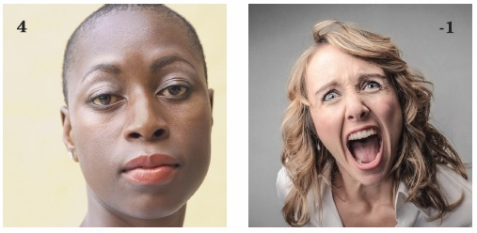
Figure 6.4 Racial Biases Can Shape Our Social Perceptions

Slide 18
Aversive Racism
Form of ambivalent prejudice
Egalitarian beliefs + internalized negative stereotypes about racial minorities
The negative component may be outside conscious awareness.
The possibility of holding negative attitudes threatens self-concept as a fair-minded person.
Can result in response amplification: exaggerated positive and negative responses to minority group members

Slide 19
Sexism
Prejudice/discrimination based on a person’s sex
Persists despite close contact between groups (men and women)
Often ambivalent
Hostile attitudes state women are inferior.
Benevolent attitudes state women are in need of protection and special treatment.
Strongest negativity directed toward women who go outside of traditional gender roles.

Slide 20
Weight Prejudice
Individualist cultures assume that weight is controllable.
Therefore, they believe an obese person is obese because of moral failings.
Twofold stigma: physical appearance and character
Stigma is stronger for obese women than men.
Courtesy stigma: Normal-weight people who are in the company of obese people are judged negatively.

Slide 21
Sexual Prejudice
Prejudice/discrimination based on sexual orientation
Based in hetereosexism
The belief that hetereosexuality is the only acceptable orientation
Both overt and subtle forms are common.
Tied to social-conservative value systems

Slide 22
Mental Illness Prejudice
Belief that mentally ill people are dangerous and less capable than others
People with psychological problems often conceal their symptoms.
Research suggests there are very little (if any) differences in violence between those who were former patients in mental hospitals and control groups.

Slide 23
Stereotype Threat
When you are performing a task where you know your group is stereotyped to perform poorly, your performance suffers.
Arousal increases the cognitive load.
The focus shifts to avoiding errors rather than doing well.
Subtle cues can induce stereotype threat.
Stereotype threat is strongest for people who want to do well the most.

Slide 24
Consequences of Stereotype Threat
Short-term consequences
Lower test scores
Depleted self-regulation
Long-term consequences
Disidentification with academic area/career
Self-fulfilling prophecies
Fortunately, stereotype threat can be reduced.

Slide 25
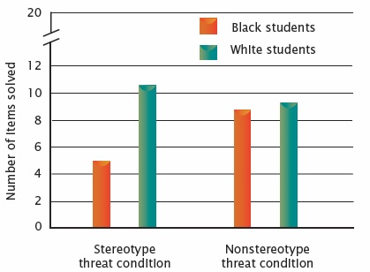
Figure 6.5 African American Intellectual Test Performance and Stereotype Threat

Slide 26
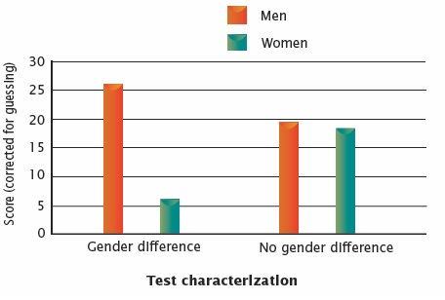
Figure 6.6 Stereotype Threat and Women’s Math Performance

Slide 27
Ingroup Bias
One factor behind prejudice
The implicit preference for one’s own group is very strong.
Bias emerges even for temporary, arbitrary groups.
Bias may be motivated by desire for positive social identity.

Slide 28
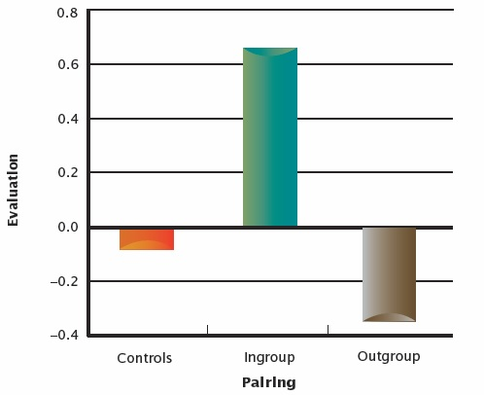
Figure 6.7 Us and Them: Ingroup Biasing

Slide 29
Intergroup Conflict
Realistic group conflict theory: Groups develop hostility because they compete for scarce resources.
In conflict, ethnocentrism increases
More hostility toward outgroup
More loyalty toward ingroup

Slide 30
Robbers Cave Experiment
Randomly assign normal children to two groups at camp.
Create ingroup identity through cooperative activities.
Stage intergroup competition.
Boys became hostile to the “other” side
Require intergroup cooperation.
Imposed superordinate goals
Attitudes toward outgroups became more positive

Slide 31
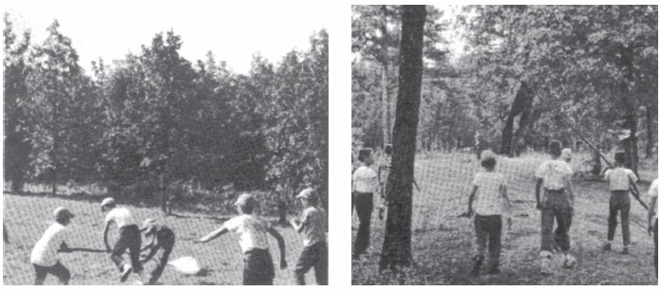
The Robbers Cave Experiment

Slide 32
Social Dominance Theory
Groups in a society are hierarchical.
Groups at the top get a disproportionate share of wealth, prestige, education, and health.
Groups at the top develop prejudice against those at the bottom.
As people move up the hierarchy, they generally develop less egalitarian beliefs.
Individuals differ in their social dominance orientation.

Slide 33
System Justification Theory
Members of disadvantaged groups may still endorse status hierarchy as legitimate.
People minimize the extent to which they personally experience discrimination.
Even while acknowledging that it is a problem for their group
Personal-group discrimination discrepancy

Slide 34
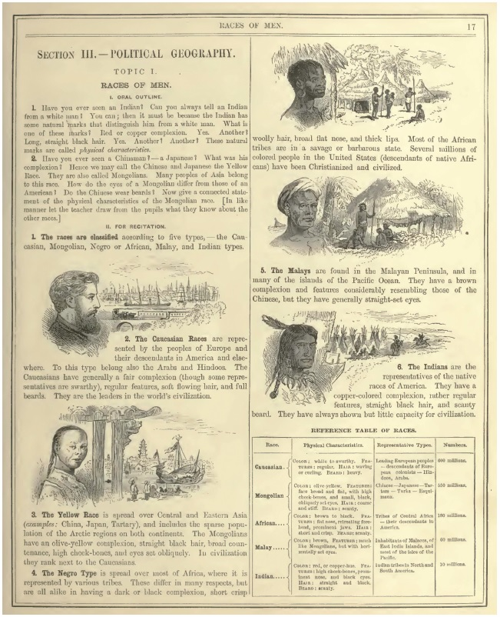
Figure 6.8 An Example of Racist Attitudes in an Old American Textbook

Slide 35
Authoritarianism
Authoritarian personalities are:
Submissive to authority figures
Intolerant of those weak or different
Prone to contemptuous prejudice
Rigid in their moral codes
More likely to act on hostile feelings
Transmitted by social learning

Slide 36
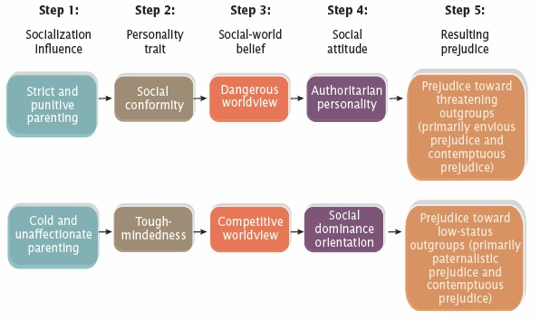
Figure 6.9 A Dual-Process Model of Personality- Influenced Prejudice

Slide 37
Reducing Intolerance
Self-awareness and self-regulation can disrupt automatically-activated stereotypes.
Long-term practice at unprejudiced responses can produce change.
But not without error
Targets of prejudice can “break the silence.”
Can produce positive change
Can be difficult or uncomfortable

Slide 38
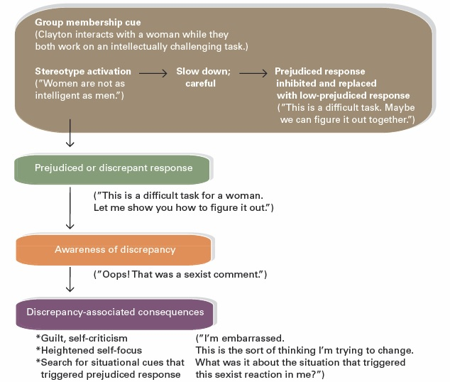
Figure 6.10 Reducing Prejudiced Responding Through Self-Regulation

Slide 39
Contact Hypothesis
Intergroup attitudes will improve when:
Groups have equal social status in the setting
Groups have sustained close contact
Groups cooperate toward superordinate goals
Social norms favor equality
Group members have the opportunity to form friendships

