Slide 1
Chapter 5: Attitudes and Persuasion

Slide 2
Learning Objectives
Can you have an unconscious attitude toward something that is opposite of your conscious attitude?
Can you form an attitude toward something without forming any beliefs about it?
Does an attitude cause you to behave in a way consistent with that attitude, or does behaving a certain way cause you to form an attitude consistent with that behavior?
What impact do emotions and humor have on the ability to persuade others to change their attitudes?

Slide 3
Attitudes
Evaluative tendency toward an object
Tendency to evaluate is automatic.
Examples:
Self-esteem
Interpersonal attraction
Prejudice
Friendship

Slide 4
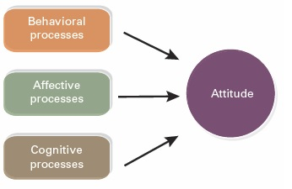
Figure 5.1 Three Different Types of Attitude Antecedents

Slide 5
Implicit vs. Explicit Attitudes
Implicit attitude is activated automatically from memory.
Outside conscious awareness
Simple, gut-level evaluations
Explicit attitude
Consciously held
Careful and deliberate
Implicit and explicit attitudes may contradict each other.
Dual attitudes

Slide 6
Implicit Association Test
One way to measure implicit attitudes
Pairs categories of items with positive and negative stimuli
Press a key if the stimulus is good or refers to women.
Press a different key if the stimulus is bad or refers to men.
Then, reverse the pairings (good = men; bad = women) and repeat.
Assesses reaction time to see if you are faster at pairing good things with one category or the other.
https://implicit.harvard.edu/implicit/takeatest.html

Slide 7
Reference Groups
A group
To which we orient ourselves
With which we emotionally identify
Whose standards we use to judge ourselves and others
Newcomb's Bennington College study showed that the effects of reference groups are profound.

Slide 8
Mere Exposure
Seeing an unfamiliar stimulus many times can lead to liking.
As long as you do not have initial negative reactions to it
Requires no knowledge of the object
Possible explanation: Familiar objects are unlikely to be dangerous.

Slide 9
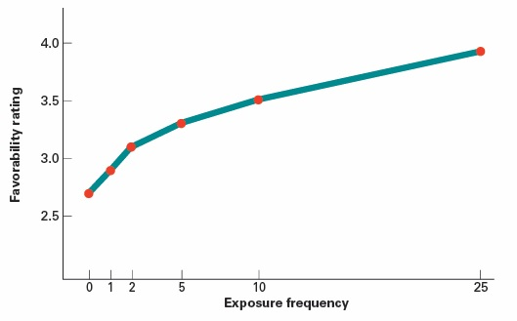
Figure 5.2 Frequency of Exposure and Liking

Slide 10
Classical Conditioning
Basic model:
UCS → UCR
UCS + CS → UCR
CS → CR
Classical conditioning can lead to attitude formation, for example, toward social groups.
Group labels (UCS) paired with negativity in the environment (CS) can produce dislike for the group (CR).

Slide 11
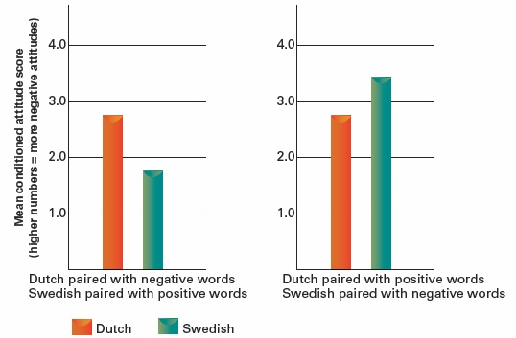
Figure 5.3 Classical Conditioning of Attitudes Toward Different Nationalities

Slide 12
Operant Conditioning
When a behavior is rewarded, it is more likely to occur in the future.
Receiving praise for holding an attitude is likely to strengthen the attitude.
Attitudes can be shaped by observational learning.
Watching the way others are rewarded or punished as they interact with an attitude object

Slide 13
Attitudes and Nonverbal Behavior
Smiling or frowning can cause a change in mood.
Facial feedback hypothesis
Vascular theory of emotion
Posture and body motion can change mood.
People are unaware of the causes of the mood.

Slide 14
Cognitive Dissonance Theory
We wish to appear consistent in our thoughts and behavior.
Inconsistency is uncomfortable and aversive.
To avoid or reduce the aversive feeling, we engage in the following:
Irrational behavior
Cognitive distortions
Rationalization
Attitude change (to fall "in line" with recalled behavior)

Slide 15
Insufficient Justification
Small-reward group liked a boring task more than the big-reward group.
Contrary to behaviorist predictions
Why?
The big-reward group had a clear reason to follow the instructions → no dissonance.
The small-reward group had no good reason to follow the instructions → dissonance.
I can't change what I did, so dissonance is removed. I have to change what I believe. This task wasn't so bad.

Slide 16
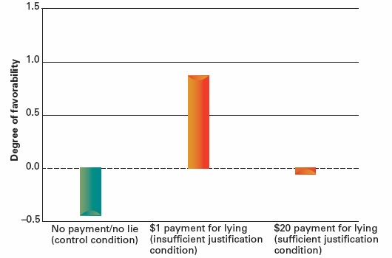
Figure 5.4 Insufficient Justification Induces Dissonance and Motivates Attitude Change

Slide 17
Freedom of Choice and Dissonance
A person forced into a behavior experiences no dissonance, even if she/he doesn't like the behavior.
I did it because I had to.
A person who freely chooses behavior she/he doesn't like experiences dissonance.
I did it + I don't like people who do it → contradiction
Can't change what I did, so I'll change my attitude.
I guess that behavior isn't so bad after all.

Slide 18
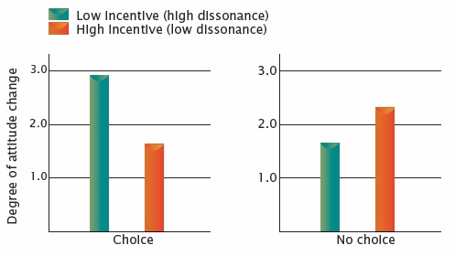
Figure 5.5 Perceived Choice, Incentive, and Attitude Change

Slide 19
Justification of Effort and Dissonance
The harder (more unpleasant, dangerous, costly, degrading) it is to accomplish something, the more a person values it.
Once they have completed the effort
If they don't value it, dissonance occurs.
I am a smart person + I just subjected myself to humiliation to get into this group + this group stinks
Dissonance reduction: This group is great. It was worth it.
Examples: boot camp, fraternity/sorority hazing

Slide 20
Immoral Behavior and Dissonance
Moral hypocrisy: motivation to appear moral while avoiding costs of doing so
After committing a moral transgression, people:
Justify the transgression
Become more tolerant of immoral conduct

Slide 21
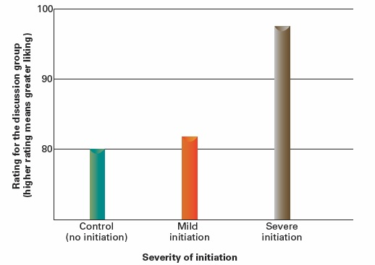
Figure 5.6 Cognitive Dissonance and the Effects of Initiations

Slide 22
Postdecision Dissonance
"Buyer's remorse"
Regret that an alternative was not chosen
Like all dissonance, this is aversive.
I am a smart person + I chose the wrong thing
We then change our perceptions of the alternatives we have.
Emphasize good points of the thing we chose
Emphasize bad points of the thing we didn't choose

Slide 23
Variations in Cognitive Consistency
Consistency is more integral to individualist than collectivist societies.
Behavior within collectivist societies is ideally more concerned with being appropriate to the situation than with being consistent.
Within a given society, there are people with different tolerances for dissonance.

Slide 24
Self-Perception Theory
Proposes that we infer our attitudes from observing our own behavior
The same way we infer others' attitudes
More likely when:
Behavior is freely chosen
Attitude is vaguely defined
We have little experience with attitude object
May be how implicit attitudes become explicit

Slide 25
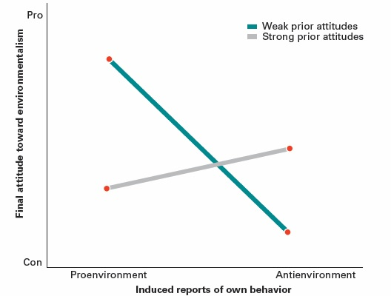
Figure 5.7 Self-Perception of Environmental Attitudes

Slide 26
Theory of Planned Behavior
Explains carefully reasoned actions
Attitudes are only one influence on behavior.
Attitude-behavior link may be weak
Does not account for "mindless" behavior

Slide 27
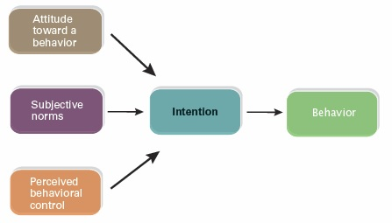
Figure 5.8 Theory of Planned Behavior

Slide 28
Elaboration Likelihood Model
Central route to persuasion: People carefully scrutinize the message.
Peripheral route to persuasion: People rely on heuristics or other "effortless" processes.
Attitudes formed through central route processing are:
Stronger
Less prone to counterarguments
More predictive of behavior

Slide 29
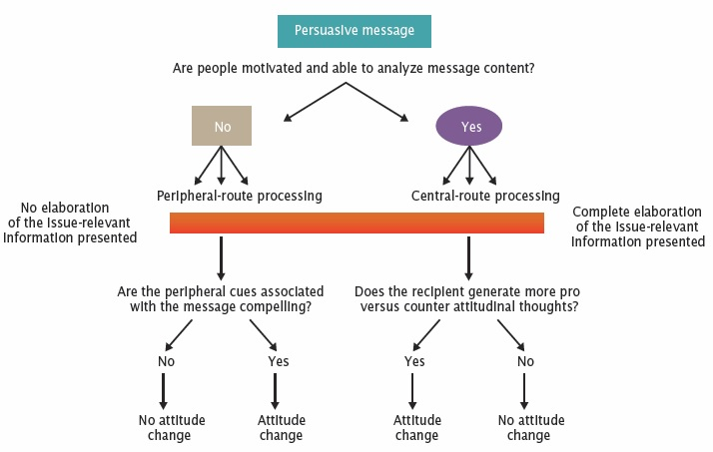
Figure 5.9 Two Routes to Persuasion

Slide 30
Source Factors Influencing Persuasion
Credibility
Low credibility is a discounting cue.
However, over time, the source's lack of credibility may be forgotten (the sleeper effect).
Attractiveness
Likeability
Similarity to audience
Physical appearance

Slide 31
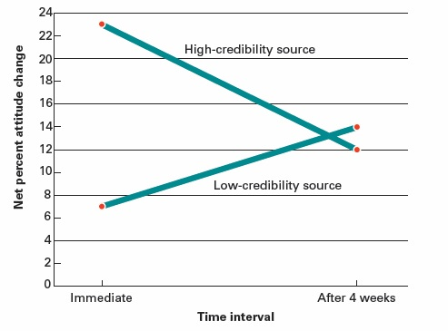
Figure 5.10 The Sleeper Effect

Slide 32
Message Factors in Persuasion
Rapid speech increases persuasion through peripheral routes.
Emotions can serve as information in the persuasion process, or as motivations to avoid a message.
Fear can induce helplessness if no clear alternative to the feared outcome is presented.
Humor is effective when it is relevant to the message.

Slide 33
Resistance to Persuasion
Two-sided messages can inoculate a person from an opposing view.
Present a weak view of the opposing view along with the counterargument
Actively generating counterarguments
Increases confidence in an initially strong attitude
Does not increase confidence in an initially weak attitude

Slide 34
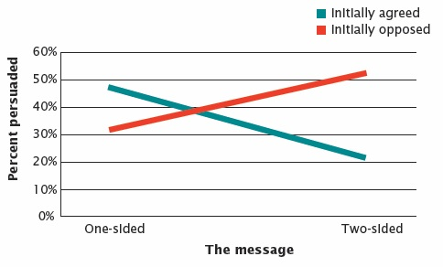
Figure 5.11 One-Sided Versus Two-Sided Appeals

Slide 35
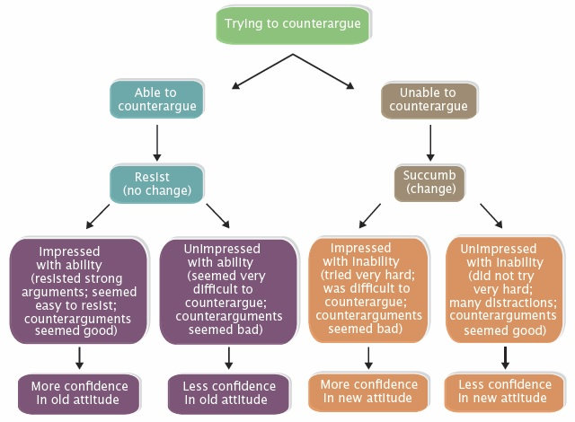
Figure 5.12 A Model of Attempted Resistance to Persuasion

