Slide 1

Chapter 7: Memory

Slide 2
Chapter Outline
The Nature of Memory
What Constitutes Long-Term Memory
How Do We Retrieve Information from Memory?
How Does Forgetting Occur?
What Is the Biological Basis for Memories?

Slide 3
Learning Objectives
Understand the different models of memory.
Understand how long-term memory is organized.
Understand some of the causes of memory retrieval can cause difficulties.
Understand how and why forgetting can occur.

Slide 4
Definition of Memory
Memory is the mental process by which information is encoded and stored in the brain and later retrieved.
How much do you think human memory can hold?

Slide 5
Information-Processing Model of Memory
Information-processing model suggests that information goes through three basic processes:
  Encoding: the first memory process where information is organized and transformed
  Storage: the second memory process where information is maintained
  Retrieval: the third memory process where information is recovered so it can be used

Slide 6
Ebbinghaus and Memory
Hermann Ebbinghaus (1850-1909) studied memory and used himself as his own subject.
The memory curve has two effects:
  Primacy effect: increased memory for items near the beginning of a list
  Recency effect: increased memory for items near the end of a list

Slide 7
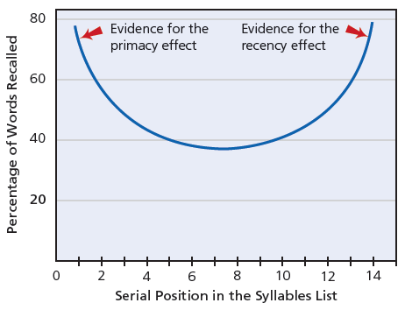
Figure 7-1: The Memory Curve

Slide 8
LTM and STM
Long-term memory: a durable memory system that has immense capacity
Short-term memory: a limited-capacity memory system through which we actively “work”
Sensory memory: a memory system that very briefly stores sensory information

Slide 9
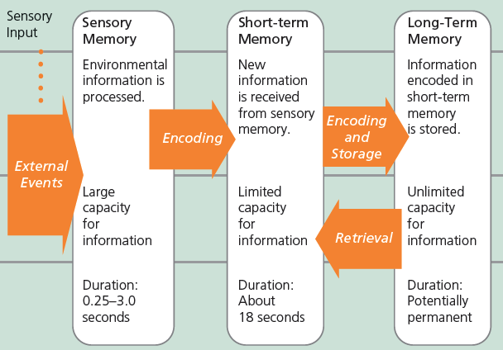
Figure 7-2: Overview of the Information-Processing Model of Memory

Slide 10
STM is a Working Memory System
Working memory is a term used to describe STM as an active memory system with three components.
  Phonological loop
  Visuospatial sketchpad
  Central executive

Slide 11
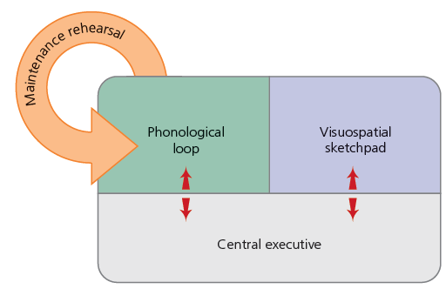
Figure 7-3: Short-Term Memory as Working Memory

Slide 12
Memory and Rehearsal
Maintenance rehearsal is the process of repetitively verbalizing or thinking about information past the 18th-second duration of STM.
Elaborative rehearsal involves thinking about how new information relates to information already stored in LTM.

Slide 13
Shallow vs. Deep Processing
Shallow processing involves encoding information superficially.
Deep processing involves encoding information in terms of its meaning.
Do you memorize words or try to make meaning of them?

Slide 14
Explicit Memory
Explicit memory is memory of previous experiences that one can consciously recollect.
Episodic memory is memory for factual information, acquired at a specific time and place (e.g., vacation).
Semantic memory is memory for general knowledge about the world that is not associated with a time and place when the information was learned (e.g., the first president of the U.S.).

Slide 15
Implicit Memory
Implicit memory is memory of previous experiences without conscious recollection (e.g., feeling uneasy).
Priming is activating implicit memories in which a recently presented bit of information primes responses.
Procedural memory is memory of how to perform skilled motor activities that have become well-learned (e.g., cooking).

Slide 16
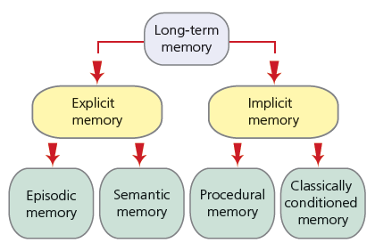
Figure 7-5: Types of Long-Term Memory

Slide 17
Semantic Network Model
Semantic network model describes concepts in LTM organized in a complex network of associations.
Concept is a a cluster of objects, ideas, or events that share common properties and are linked to to other concepts in memory (e.g., snow and winter).

Slide 18
Parallel Distributed-Processing Model
Parallel distributed-processing model is a model in which a large network of interconnected neurons distributed throughout the brain simultaneously work on different memory tasks.
Processing units are a large network of interconnected neurons.

Slide 19
Memory Retrieval (Slide 1 of 2)
Recall is a measure of explicit memory in which a person must retrieve and reproduce information from memory.
Recognition is a measure of explicit memory in which a person need only decide whether or not something has been previously encountered.
Tip-of-the-tongue phenomenon is the temporary inability to remember something you know with the feeling that it is beyond your conscious state.

Slide 20
Memory Retrieval (Slide 2 of 2)
Retrieval cue is a stimulus that allows us to more easily recall information from LTM.
State- dependent memory is the tendency for retrieval from memory to be better when our state of mind during retrieval matches our state during encoding.
Encoding specificity principle states that retrieving information from LTM occurs most often when the conditions at retrieval match original learning conditions.

Slide 21
Flashbulb Memories
Flashbulb memories are detailed and vivid memories of surprising and emotion-provoking events.
Can you think of an example of a flashbulb memory?

Slide 22
Forgetting due to Interference
Decay is forgetting due to the passage of time.
Retroactive interference is forgetting due to interference from newly learned information.
Proactive interference is forgetting due to interference from previously learned information.

Slide 23
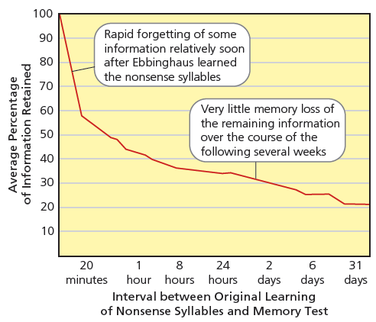
Figure 7-8: Ebbinghaus’s Forgetting Curve

Slide 24
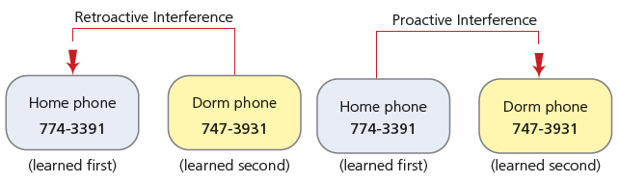
Figure 7-9: Interference in Memory

Slide 25
Amnesia
Anterograde amnesia is the inability to form long-term memories due to physical injury to the brain.
  Hippocampus is critical for LTM formation
Retrograde amnesia is the loss of information previously stored in LTM due to physical injury to the brain.
Infantile amnesia the inability to remember events that occurred before 3 years of age.

